Slide 1
D-Health
healthcare through digital technology

Slide 2
Contents
Project Charter
High-Level requirement
Use Case Description
Activity Diagram
Sequence Diagram
Entity Relation Diagram
Mockup Website
Usability Assessment
Agile Methodologies
Teamwork

Slide 3
About the Project
dHealth Platform is a telemedicine service that connects patients and doctors using digital communication technologies such as chats, phone/online calls, and video conferences. Patients can easily search for doctors, make appointments, and have remote teleconsultations with their preferred doctors. Doctors can access and manage patients' medical records, issue prescriptions, and provide medical recommendations

Slide 4
Project Charter
Project Name | dHealth Platform
Product Owner | Faye Simon
Project Overview | To develop a digital health (dHealth) platform that provides telemedical consultation services to patients. The platform will allow patients to search for doctors, make appointments, and have a teleconsultation with particular doctors remotely through online communication channels such as chats, phone/online calls, and video conferences. The platform will also enable doctors to access and manage medical records of patients, give teleconsultation, and provide medical recommendations and prescriptions to patients.
Objectives | 1. To develop a user-friendly and secure dHealth platform that provides telemedical consultation services to patients. 2. To increase accessibility to healthcare services and improve patient outcomes. 3. To improve communication between doctors and patients. 4. To improve the efficiency of healthcare services and reduce healthcare costs. 5. To establish a robust and scalable platform that can be expanded in the future to include additional features and functionalities. 6. To provide remote access to medical consultations for patients in distant areas- revolutionalizing the services
Project Deliverables | 1. A fully functional dHealth platform for telemedical consultation services, including a web. 2. Testing and quality assurance reports to ensure the platform meets the necessary security and performance standards. 3. Including project plan, requirements, design, and test cases.
Project Start / End | 15/03/2023 - 26/03/2023

Slide 5
Project Charter
Project Team |  | 1. Nyein Chan Win Naing 2. Vidath Singarapu 3. Somesh rao Coka 4. Pyae Sone Kyaw 5. Lakash Maharjan
Project Risk |  | 1. Technical challenges in developing a scalable and secure platform.(Technical risks) 2. Resistance from healthcare providers and patients to adopt the new platform.(user-adoption risks) 3. Regulatory and compliance risks related to privacy and security of patient data.(security risks) 4. Resource constraints, including budget and staffing. ( resource scarcity risks) 5. Necessity in effective and efficient operations ensuring good user experience (operational risks) 6. Possible non-compliance with laws and regulations related to healthcare services ( legal risks)
Stakeholder and Responsibilities
Stakeholder | Role |  | Responsibility
Faye Simon | Product Owner |  | Project Vision, Resources, Planning
Dr. Chutiporn Anutariya | Subject - Matter Expert |  | Provides expertise on a specific subject, maintain up-to-date experience and knowledge on the subject matter, provide advice to the team.

Slide 6
High-Level requirement (Functional)
S.No | Requirements | Type (Functional / Non-Functional)
1. | The application should allow users to Register and Login into the System. | Functional
2. | The application will allow the patients to search for Doctors | Functional
3. | The patients can have the ability to book the appointment and cancel the appointment. | Functional
4. | Ability to have a telemedical consultations like video call | Functional
5. | The platform allows the Patients/Doctors to access their medical records | Functional
6. | The patients have ability to receive, view and download the prescription. | Functional
7. | Patients can make the online payment | Functional

Slide 7
High-Level requirement (NON-Functional)
S.No | Requirements | Type (Functional / Non-Functional)
8. | The application should be user friendly. | Non-Functional
9. | The application should be mobile responsive. | Non-Functional
10. | Users should able to access web app in their respective devices (Mobile or Desktop) | Non-Functional
11. | The application should have minimum downtime | Non-Functional
12. | The application should follow all data security laws | Non-Functional

Slide 8
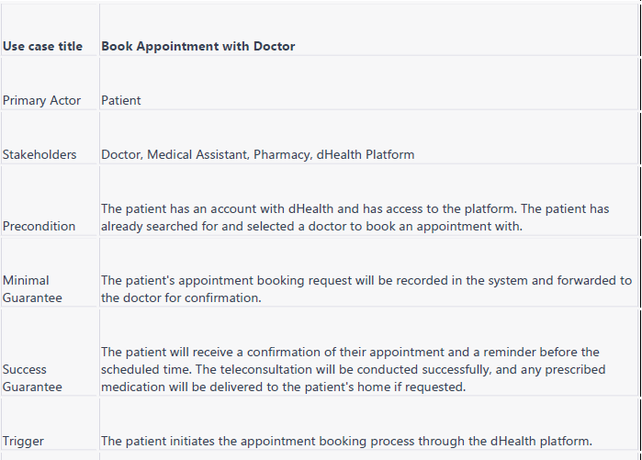
Use Case Description
Notes:
Consider talking about:
Thesaurus

Slide 9
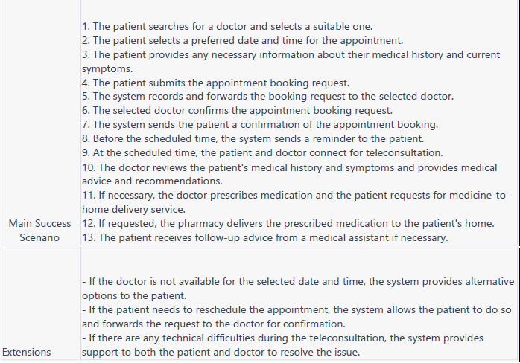
Use Case Description
Notes:
Consider talking about:
Thesaurus

Slide 10
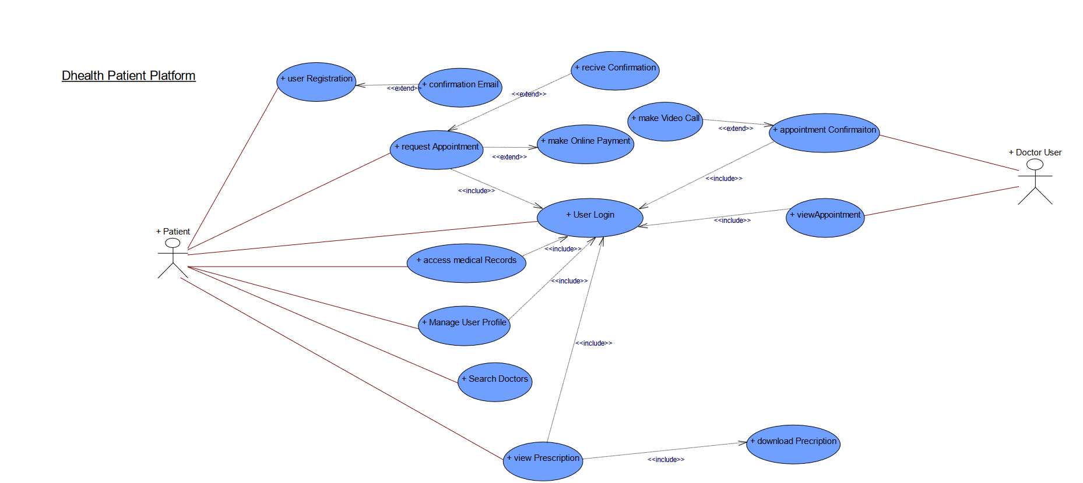
Use Case Diagram

Slide 11
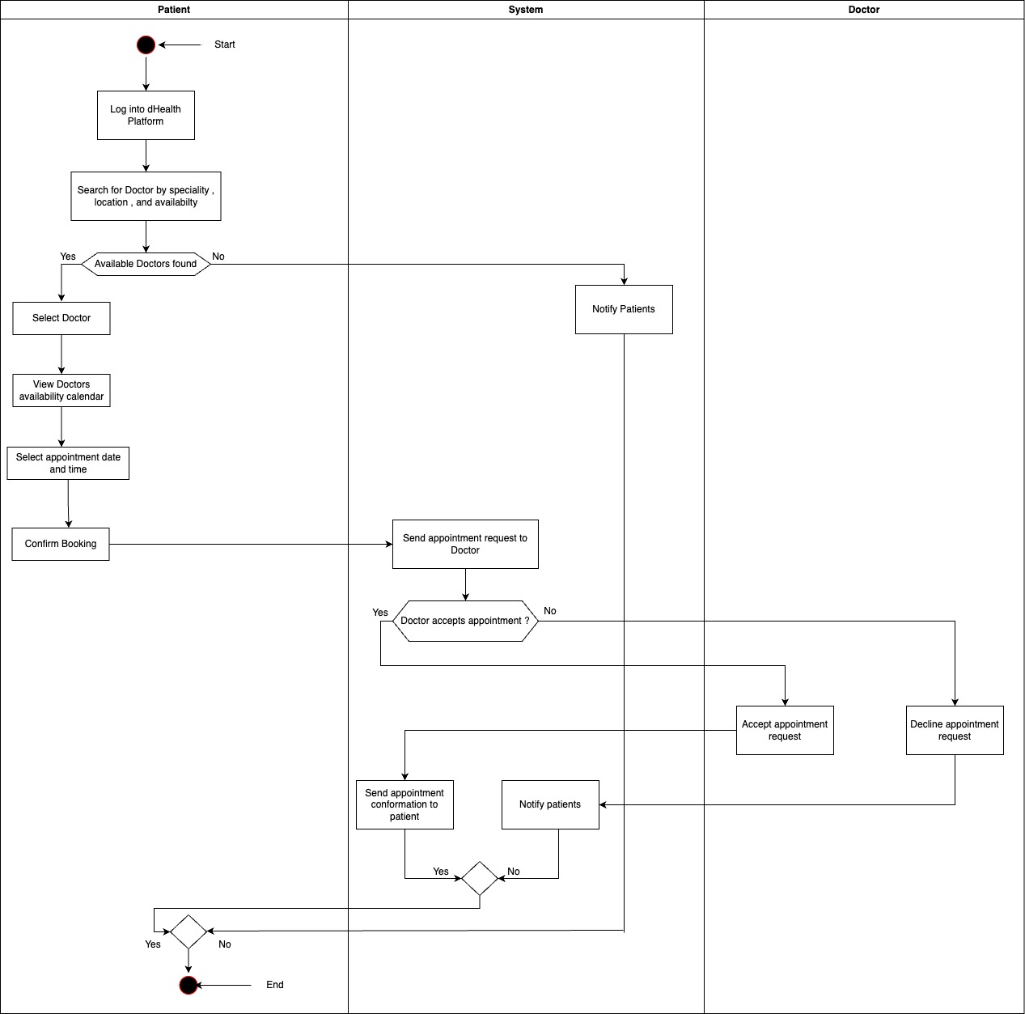
Activity Diagram

Slide 12
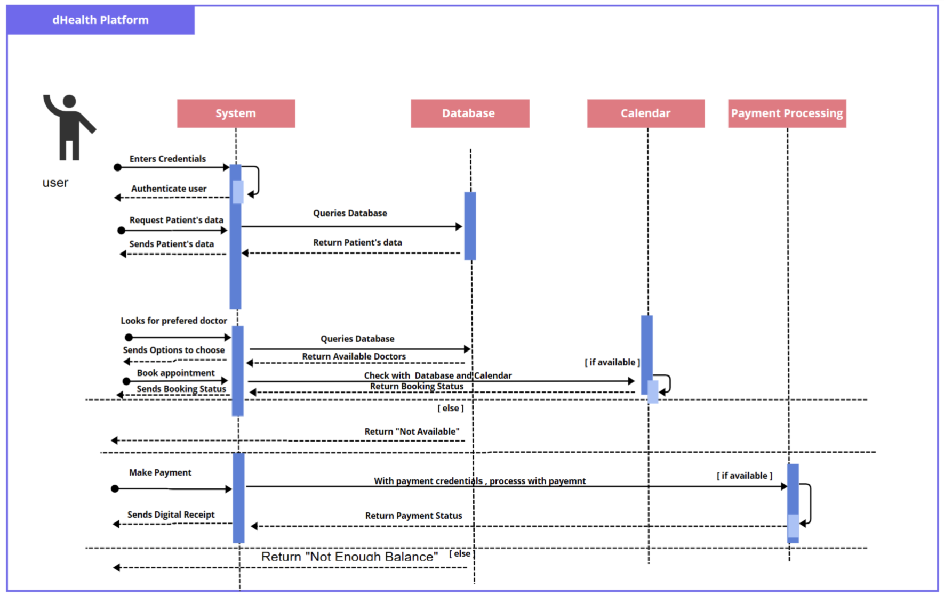
Sequence Diagram

Slide 13
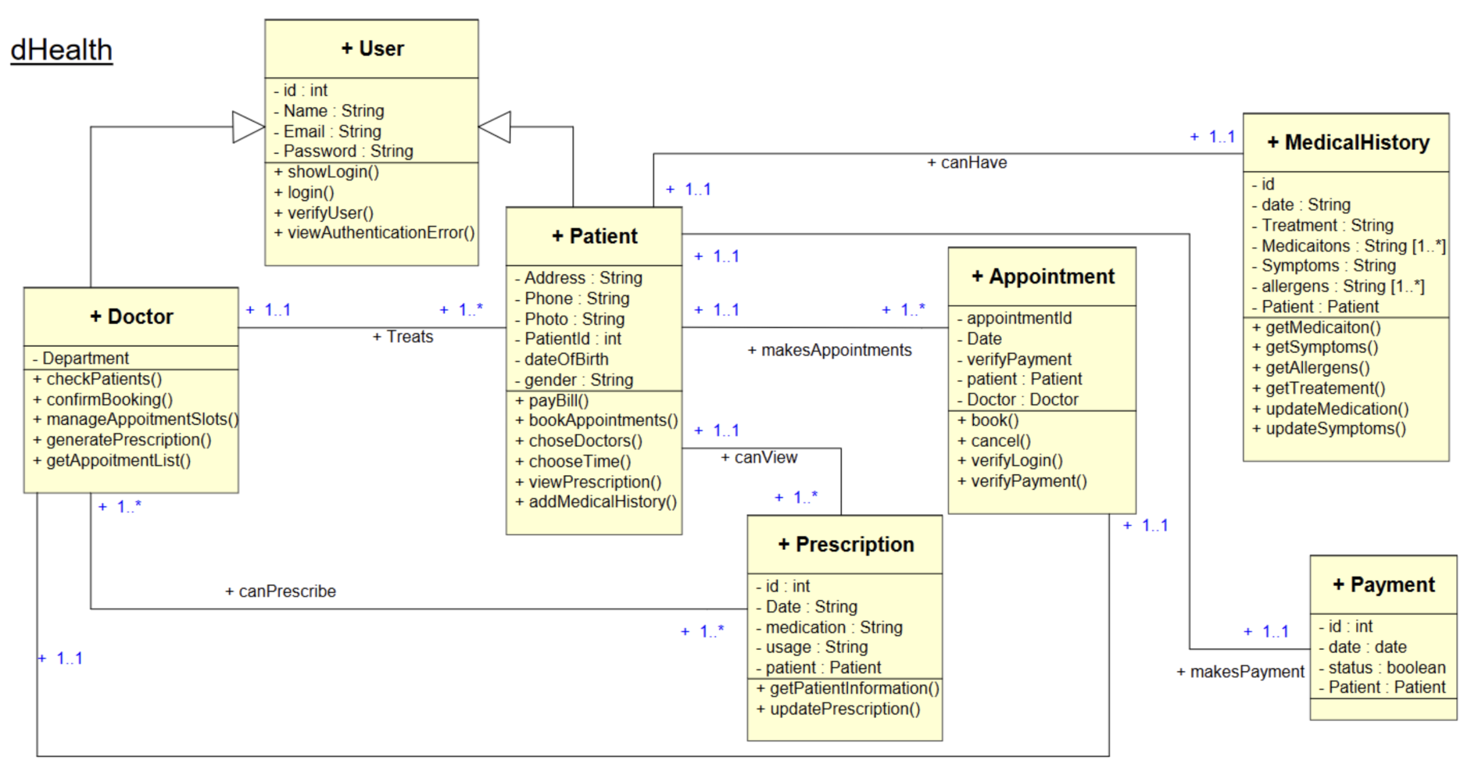
Entity Relation Diagram
Notes:
Consider talking about:
Advantages and disadvantages
Programs

Slide 14
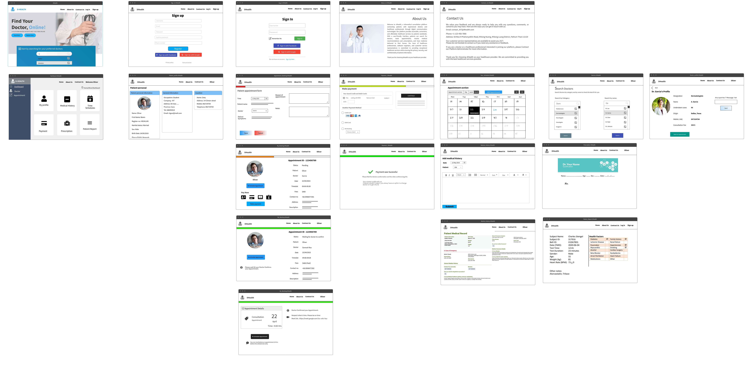
Mockup Website (Wire-frame)

Slide 15
Mockup Website
Let’s Visit

Slide 16
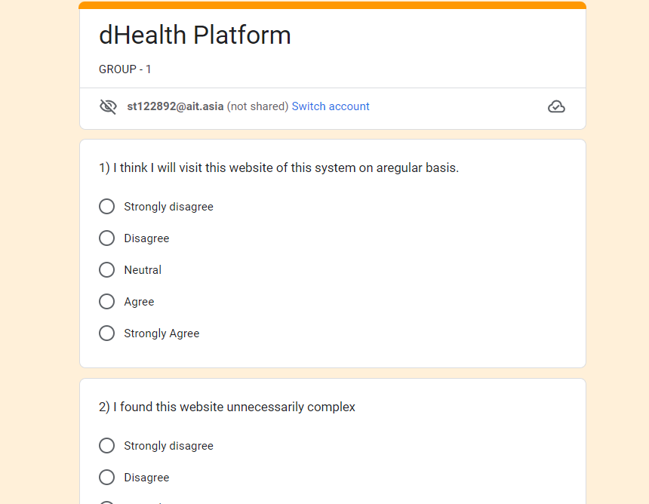
Usability Assessment

Slide 17
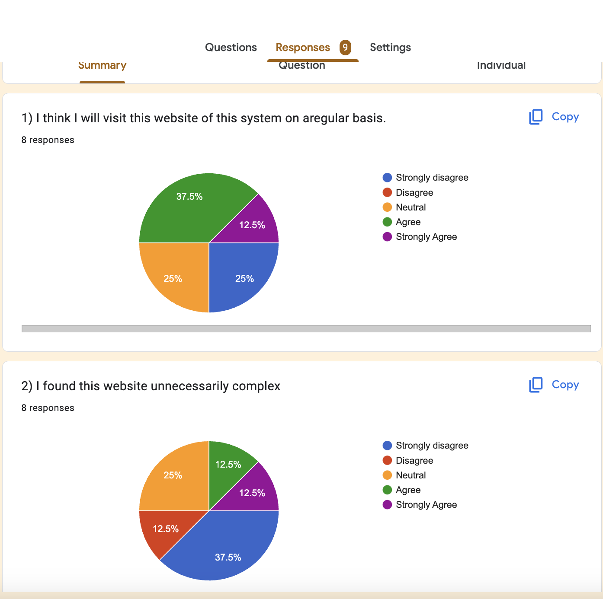
Usability Assessment

Slide 18
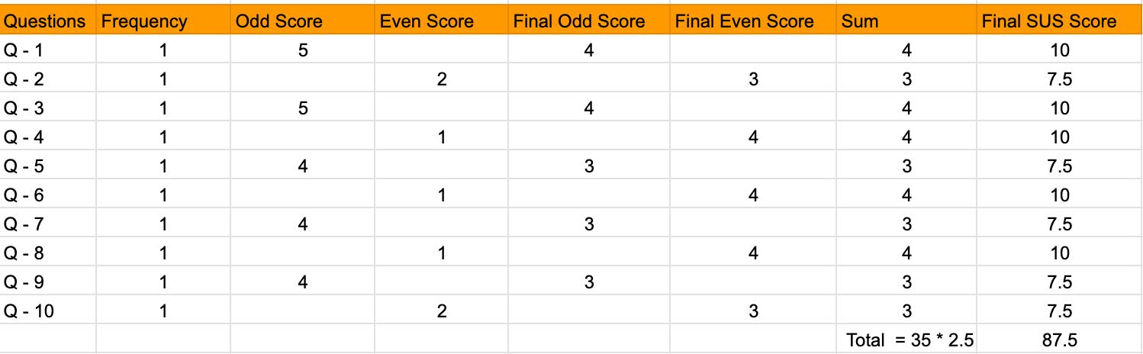
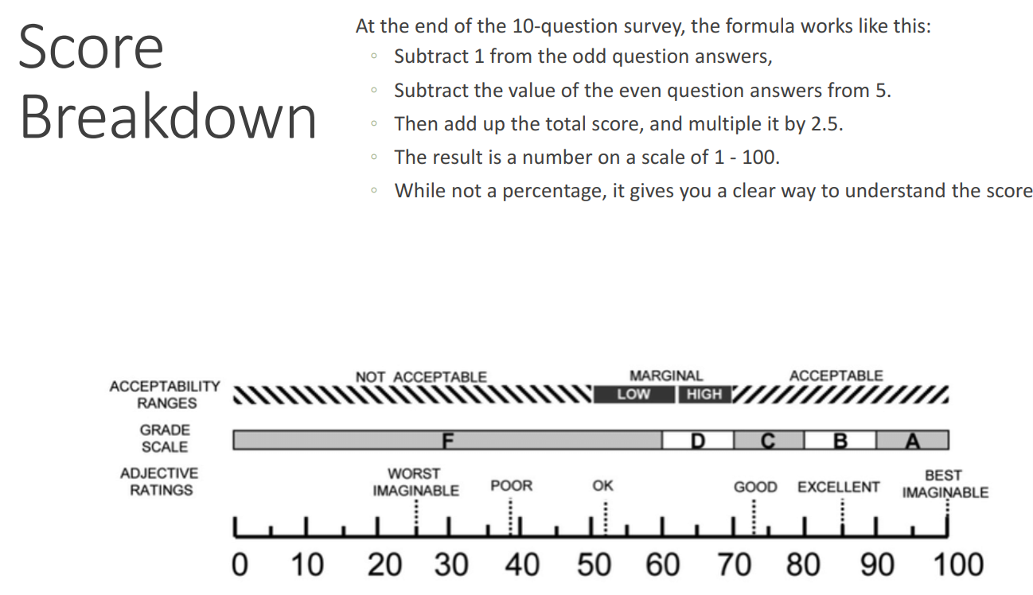
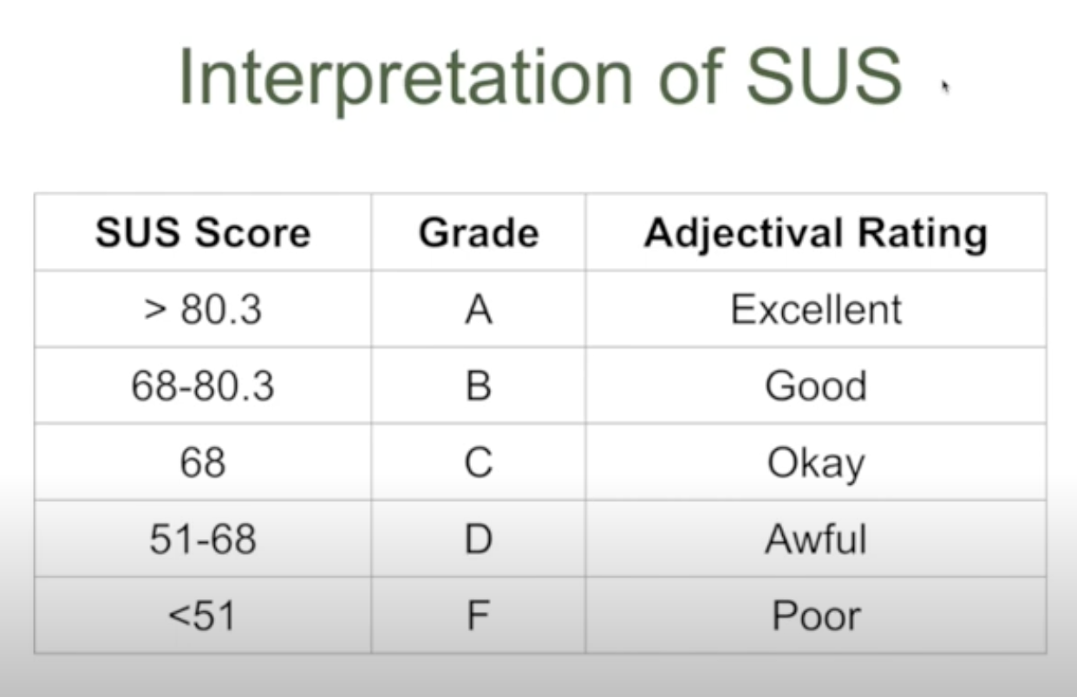
Usability Assessment
Score Calculation from SUS response result

Slide 19
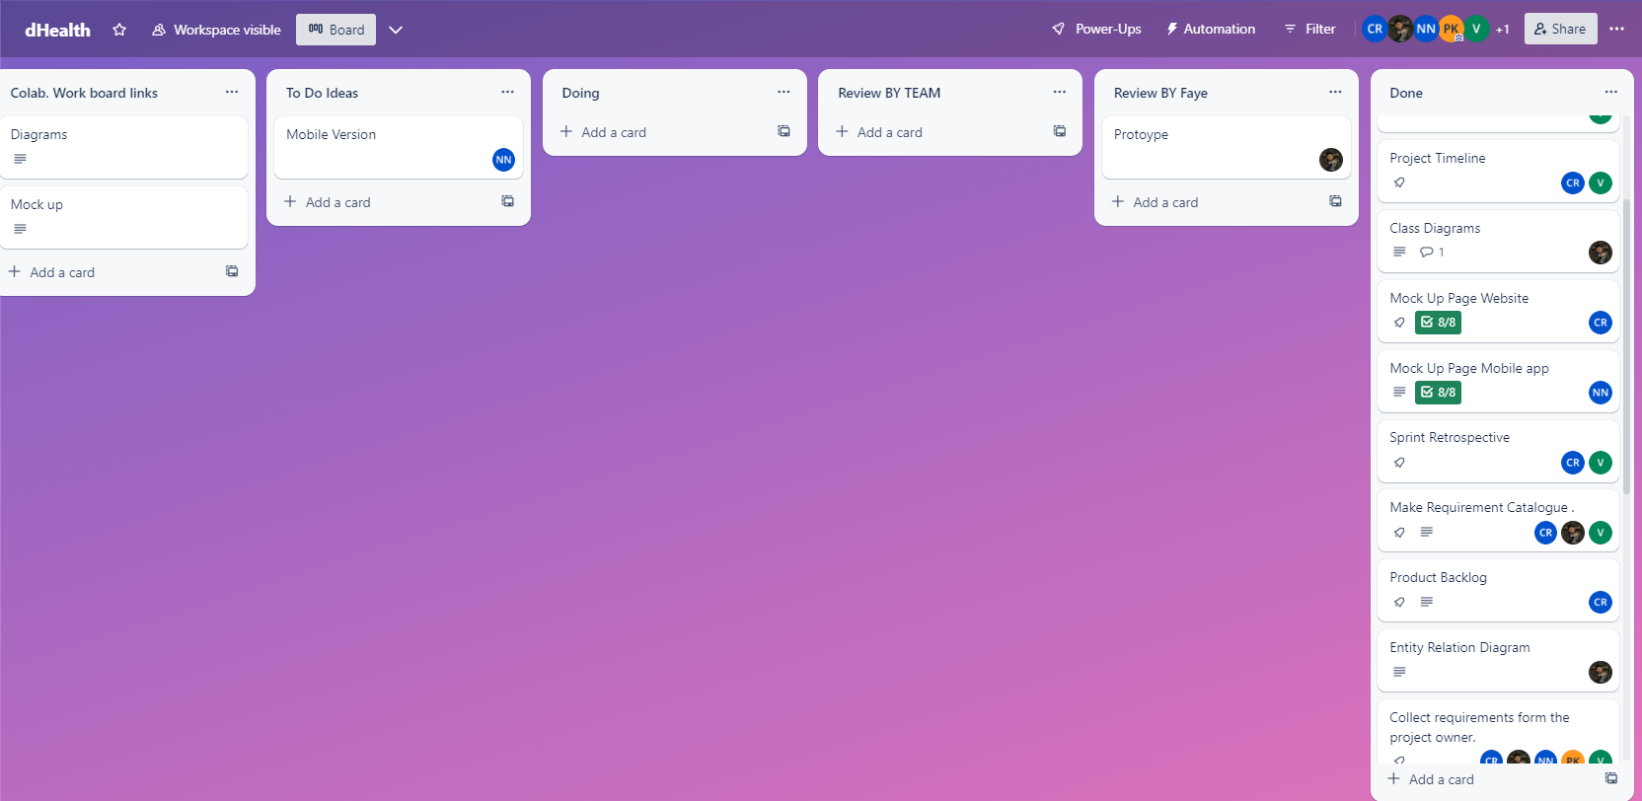
Agile Methodologies

Slide 20
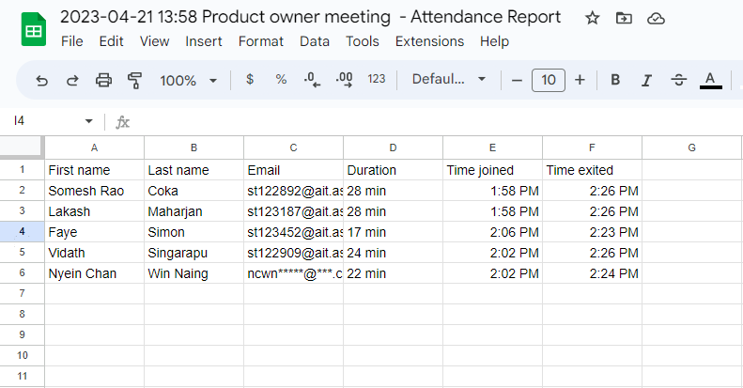
Agile Methodologies

Slide 21
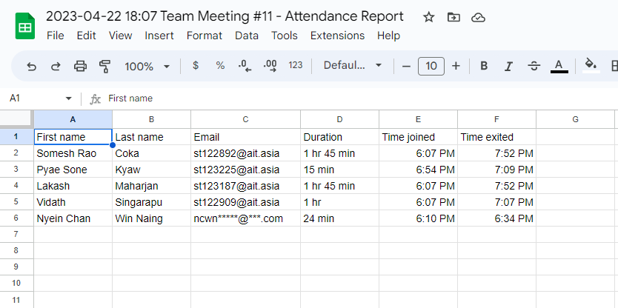
Agile Methodologies

Slide 22
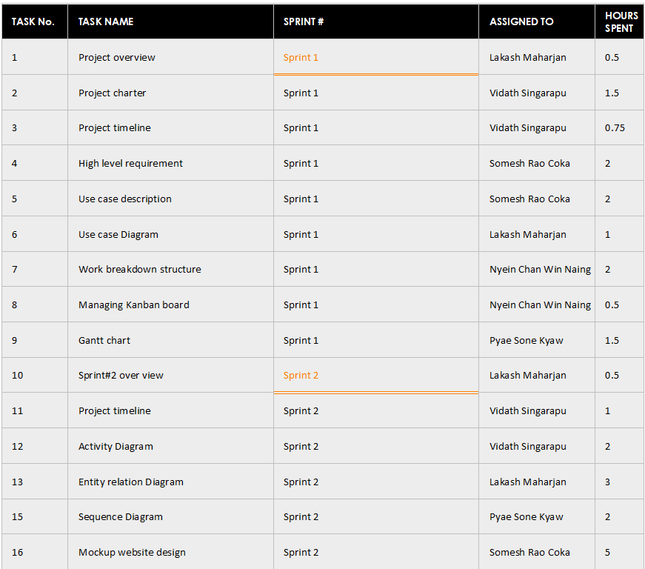
Teamwork

Slide 23
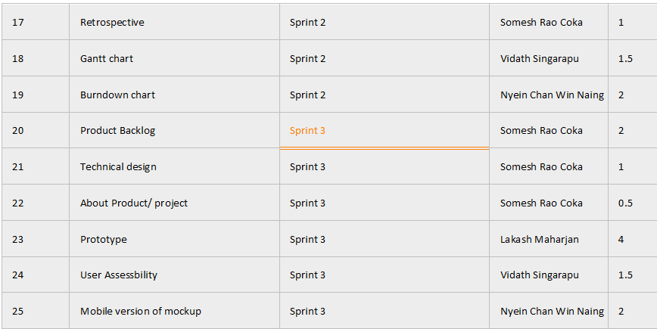
Teamwork

Slide 24
Agile Principles and Values Practiced in Our Project
Based on what we have worked on for our project, here are some Agile principles and values that have been practiced:
Individuals and interactions over processes and tools: The project team as a whole has emphasized collaboration and communication among team members over rigid processes and tools.
Working software over comprehensive documentation: The team has prioritized producing working software over extensive documentation, while still ensuring that important information was properly documented.
Customer collaboration over contract negotiation: All the team members have worked closely with the client/product owner throughout the project, seeking frequent feedback and making adjustments as necessary to ensure that the end product met the client's needs.
Responding to change over following a plan: The team has been flexible and adaptable to changes in project requirements, adjusting the plan as necessary to accommodate new information or changing priorities.

Slide 25
Agile Principles and Values Practiced in Our Project(Con’tD)
5. Emphasis on face-to-face communication: The team has prioritized face-to-face communication to promote collaboration and ensure that everyone was on the same page.
6. Iterative and incremental development: The team has broken down the project into smaller, more manageable chunks, developing and testing each piece incrementally to ensure that the end product met the client's needs.
7. Continuous improvement: The team as a progressive engine has sought to continuously improve the development process, seeking feedback from team members and the client and making adjustments as necessary to improve efficiency and quality.

Slide 26
Conclusion
Collaborating closely with the Product Owner helped us gain a deep understanding of project requirements
Applying Agile methodology in a highly effective manner
Using Jira software to create detailed user stories to refine our approach and streamline development process
Importance of time management in sprint planning
Careful allocation of time and resources helped us stay on track and meet our goals within the given timeframe
Using a Burndown chart to measure progress during each sprint allowed us to identify issues and areas requiring further attention
Comprehensive learning experience covering a wide range of skills and competencies
Gained valuable insights into building and maintaining strong relationships with clients, managing time effectively, and performing mockups and prototyping with confidence and precision
These skills are invaluable to the team and will serve well in future endeavors.

Slide 27

Our Team
Somesh
Lakash
Nyein Chan
Pyae Sone
Vidath

Slide 28

Thank you

